Slide 1

Academic Assessment Summary
(AY 2020-22)
Yimi Zhao
Office of Assessment, Institutional Research & Effectiveness (AIRE)
Academic Assessment Leadership Meeting, Sept 9, 2022

Slide 2
Table of Contents
Introduction/Background
General Education Assessment Summary
  2.1 Gen Ed assessment intro
  2.2 Gen Ed assessment data collection & AEI submission
  2.3 Gen Ed assessment results
Program Assessment Summary
  3.1 Program assessment intro
  3.2 Program assessment results
Critical Course Assessment Summary
  4.1 Critical course assessment intro
  4.2 Critical course assessment results

Slide 3
1. Introduction/Background
Three-Level Academic Assessment
College-level (General Education assessment)
  Assessed on pre-planned college wide schedule
  three-year cycle on 14 competencies/learning outcomes
Program-level assessment
  All degree programs (associate + bachelor’s)
  Assessed on departmental schedule, 3-year cycle maximum (recommended)
Course-level (critical course assessment)
  At least one qualified course per department
  Assessed on departmental schedule, 2-year cycle maximum (recommended)
College-level (Gen Ed)
Program-level
Course-level

Slide 4
2. General Education Assessment Summary
2.1 Gen Ed assessment intro
2.2 Gen Ed assessment data collection & AEI submission
2.3 Gen Ed assessment results

Slide 5
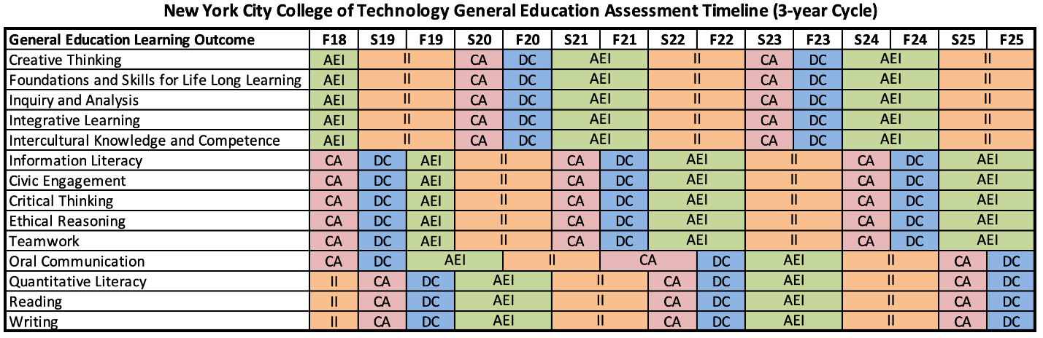
2.1 Gen Ed Assessment Intro
Note. Code for abbreviation: DC = Data Collection; AEI = Analysis of data, evaluation of report, drafting of improvement plan; II = Implement of improvement; CA = Continue improvement strategies & communication about next data collection. One cycle = DC + AEI + II + CA.
Summary focuses on DC and AEI.
Data source: General Education Assessment page on AIRE office website

Slide 6
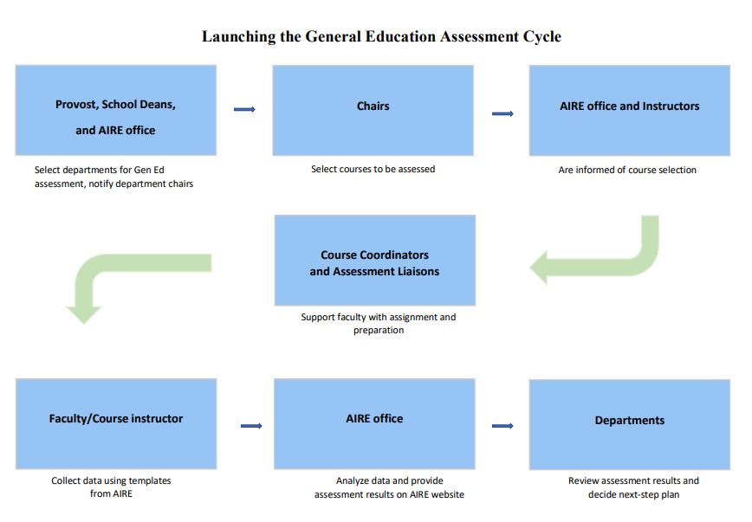
2.1 Gen Ed Assessment Intro
Data source: General Education Assessment page on AIRE office website

Slide 7
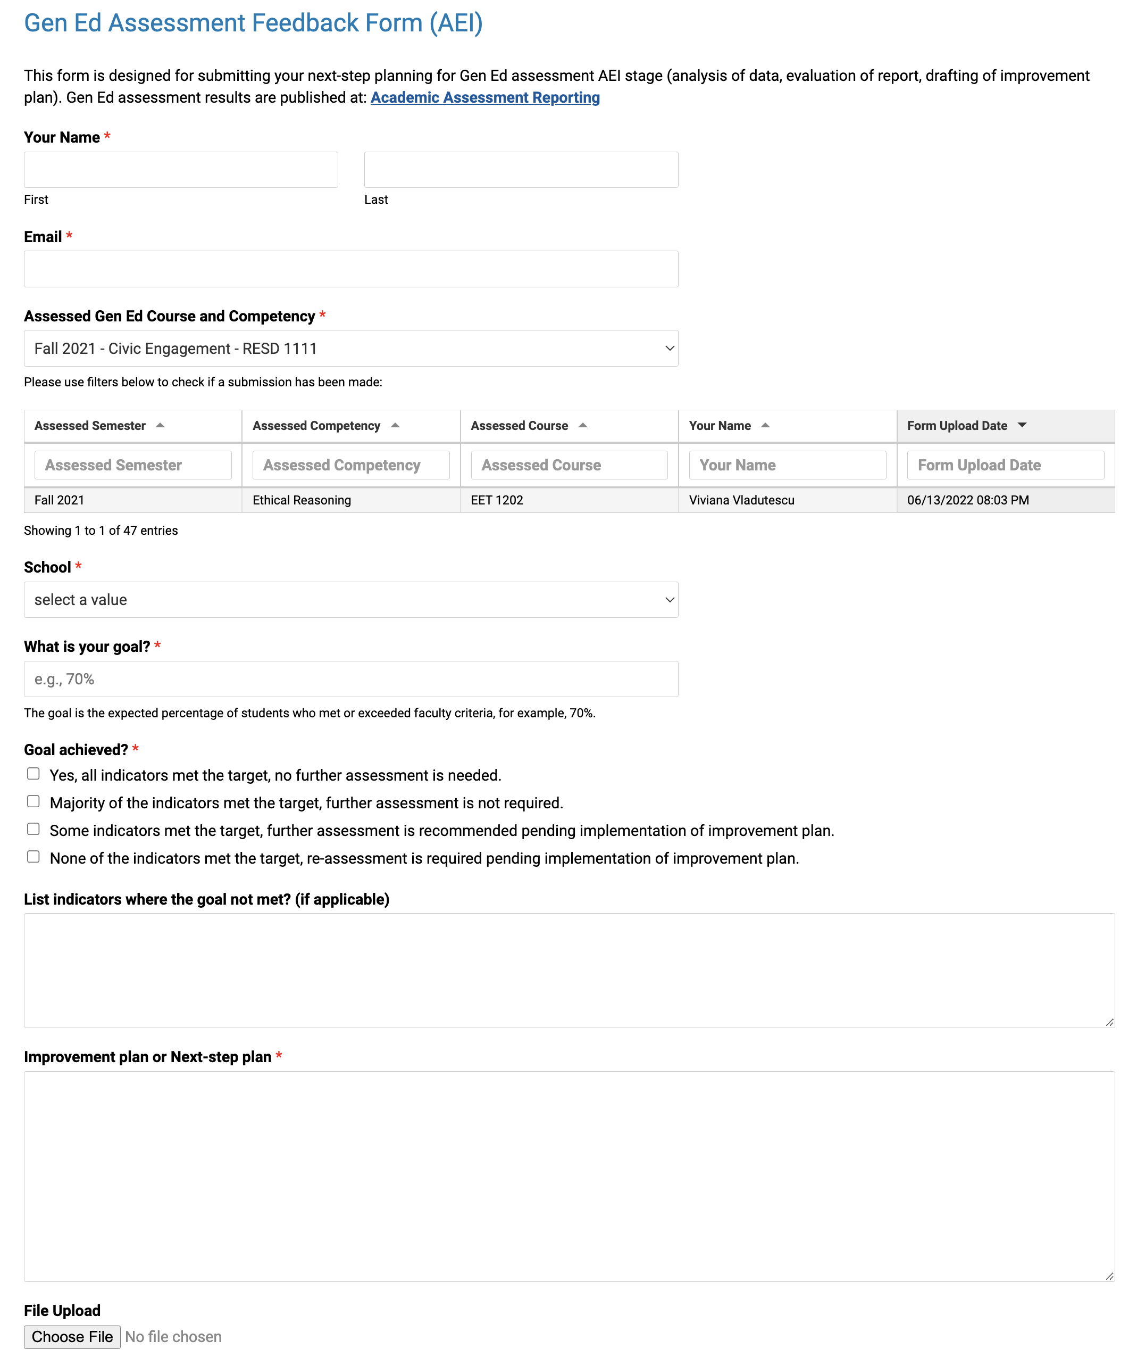
2.1 Gen Ed Assessment Intro
Data source: General Education Assessment Feedback Form (AEI) page on AIRE office website

Slide 8
2.2 Data Collection and AEI Submission Status
Gen Ed Assessment | Gen Ed (AY 2020-2021) |  |  |  |  | Gen Ed (AY 2021-2022)
 | Data collection (Fall 2020) |  |  | AEI submission (Spring 2021+ Fall 2021) |  | Data collection (Fall 2021) |  |  | AEI submission (Spring 2022)
 | planned (N) | submitted (N) | submitted (%) | submitted (N) | Submitted* (%) | planned (N) | submitted (N) | submitted (%) | submitted (N) | submitted* (%)
SoAS | 26 | 20 | 76.9% | 8 | 40.0% | 9 | 8 | 88.9% | 2 | 25.0%
SoPS | 21 | 11 | 52.4% | 9 | 81.8% | 16 | 10 | 62.5% | 4 | 40.0%
SoTD | 25 | 9 | 36.0% | 7 | 77.8% | 11 | 7 | 63.6% | 6 | 85.7%
College-wide | 72 | 40 | 55.6% | 24 | 60.0% | 36 | 25 | 69.4% | 12 | 48.0%
Note. * The AEI submission rate is based on submitted data collection.
Results updated as of 9/9/2022.

Slide 9
Note. Strikethrough cells indicate no on-time data submission. Highlighted cells indicate no AEI (analysis of data, evaluation of report, drafting of improvement plan) submission after data collection.

Slide 10

Unsatisfying 1st version of summary

Slide 11
Unsatisfying 2nd version of summary

Slide 12
2.3 General Education Assessment Results
Student evaluated
(Fall 2020)
Data source:
Academic Assessment Reporting Dashboard from AIRE Office website

Slide 13
2.3 General Education Assessment Results
Student evaluated
(Fall 2021)
Data source:
Academic Assessment Reporting Dashboard from AIRE Office website

Slide 14
2.3 General Education Assessment Results (Fall 2020)
Note. The recommended target percentage of students who met or exceeded faculty criteria is 70%.
Data source: Academic Assessment Reporting Dashboard from AIRE Office website

Slide 15
2.3 General Education Assessment Results (Fall 2021)
Note. The recommended target percentage of students who met or exceeded faculty criteria is 70%.
Data source: Academic Assessment Reporting Dashboard from AIRE Office website

Slide 16
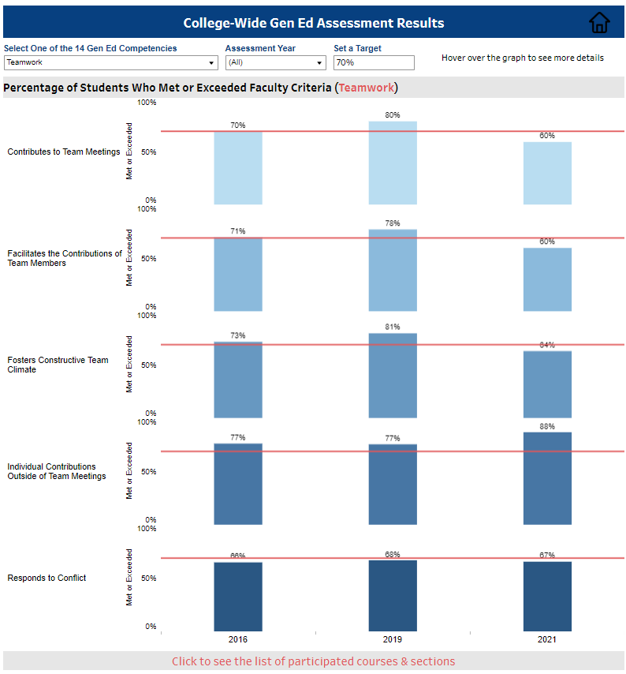
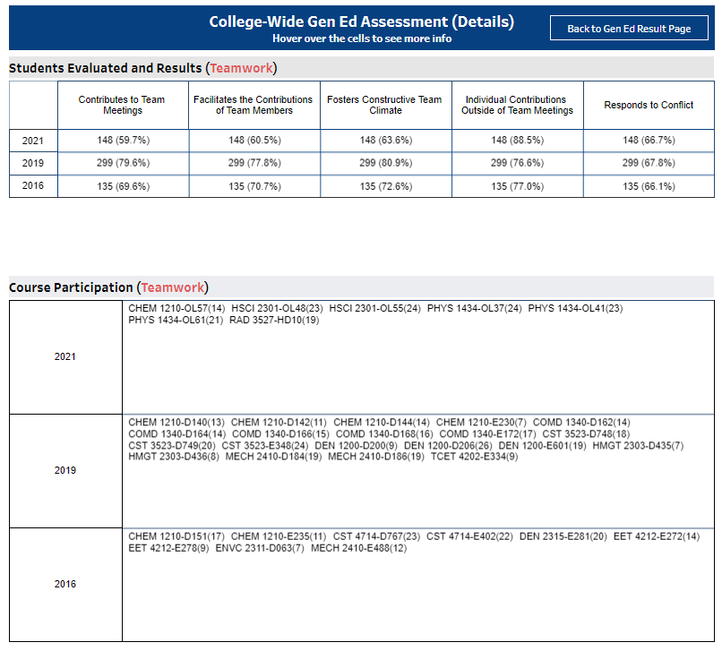
An Example from Academic Assessment Reporting Dashboard
Data source: Academic Assessment Reporting Dashboard from AIRE Office website

Slide 17
3. Program Assessment Summary
3.1 Program assessment intro
3.2 Program assessment results

Slide 18
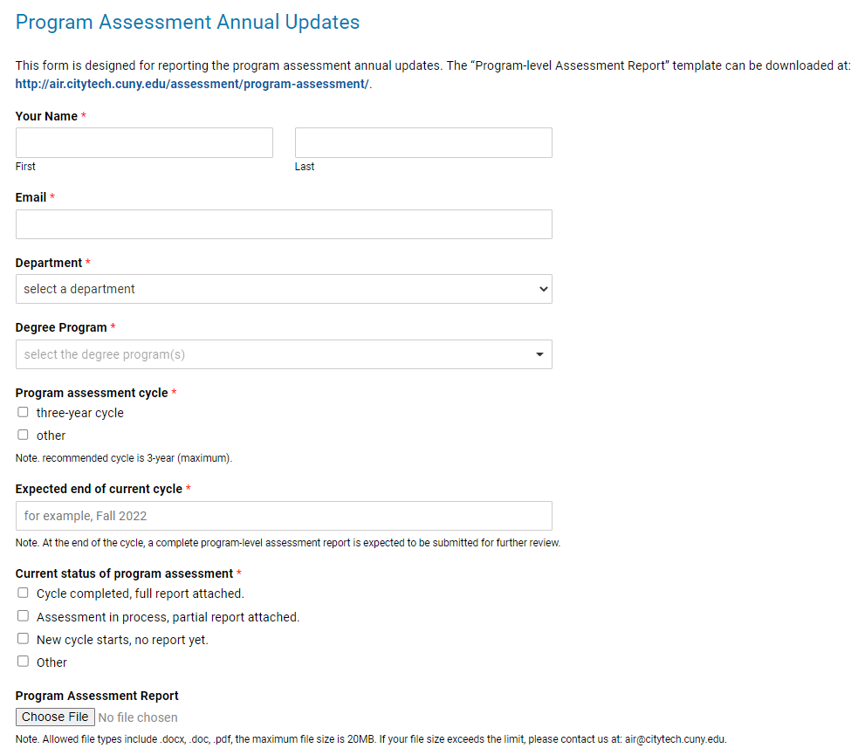
3.1 Program Assessment Intro
All degree programs (associate + bachelor’s)
On departmental assessment schedules
Recommended assessment cycle: no more than 3 years
Report annual updates via an online form every spring semester (since Spring 2021)
Data source: Program Assessment page from AIRE Office website

Slide 19
3.2 Program Assessment Results
Annual update response rates
  Spring 2021: 20/59 = 33.9%
  Spring 2022: 13/59 = 22.0%
No assessment status reported yet
  30/59 = 50.8%
8 complete reports received
Note. Results updated as of 9/9/2022

Slide 21
4. Critical Course Assessment Summary
4.1 Critical course assessment intro
4.2 Critical course assessment results

Slide 22
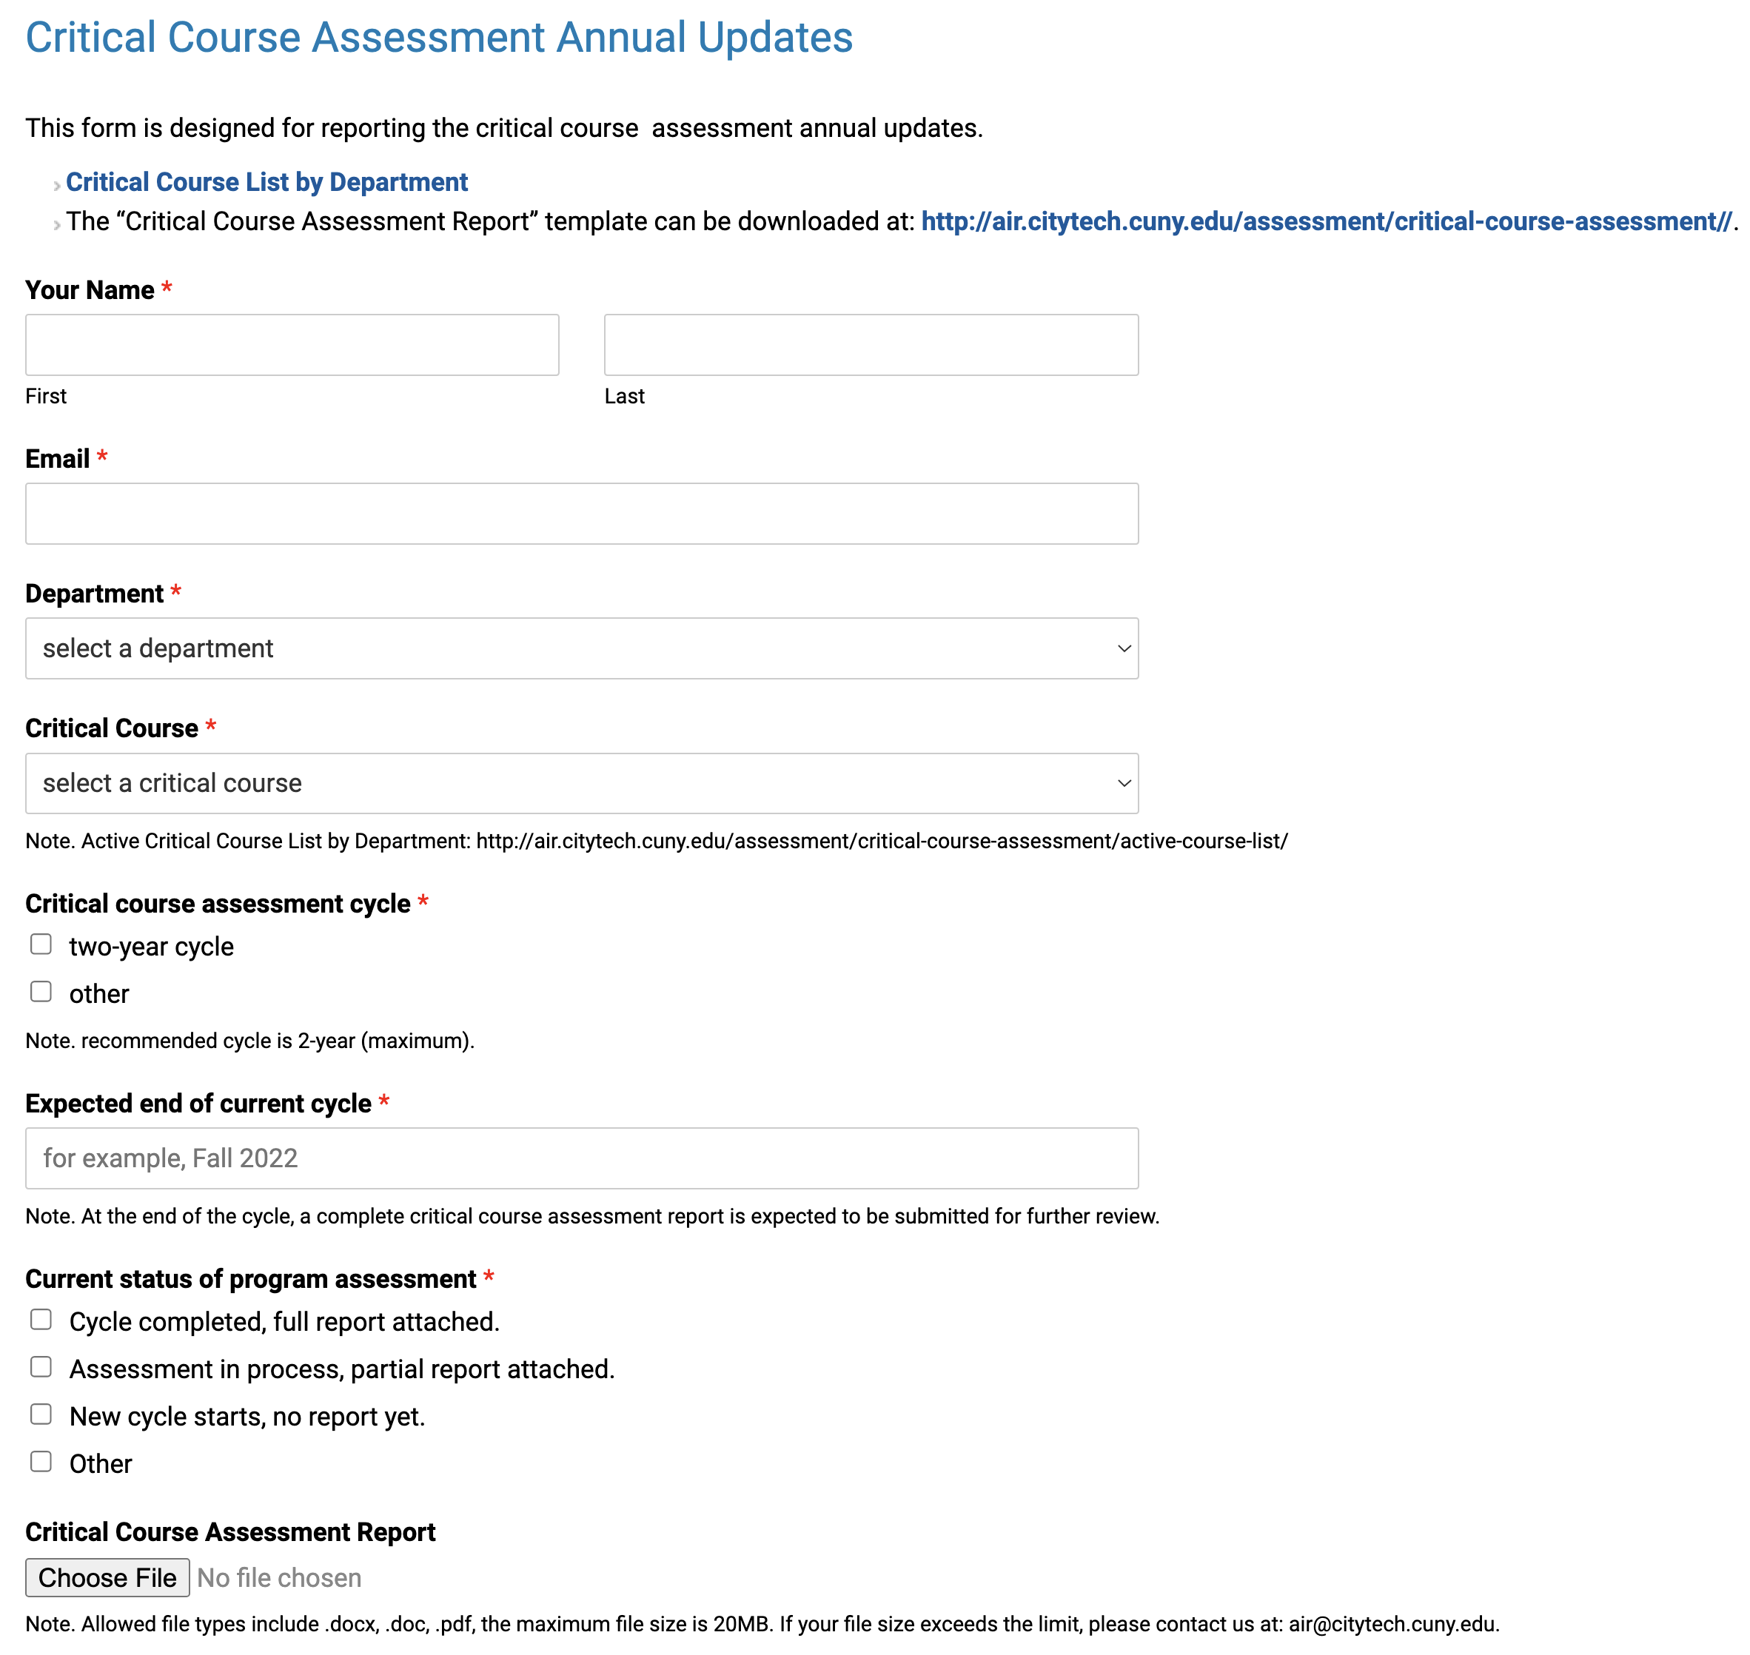
4.1 Critical Course Assessment Intro
At least one qualified course for each department
On departmental assessment schedules
Recommended assessment cycle: no more than 2 years
Report annual updates via an online form every fall semester (since Fall 2021)
Data source: Critical Course Assessment page from AIRE Office website

Slide 23
4.2 Critical Course Assessment Results
46 active, 15 inactive critical courses across 28 departments
Annual update (Fall 2021)
  response rate: 18/46 = 39.1%
  8 reports received: 4 complete reports, 4 others/partial reports
Note. Results updated as of 9/9/2022

Slide 24
critical course list by department

Slide 25
assessment status of active critical courses

Slide 26
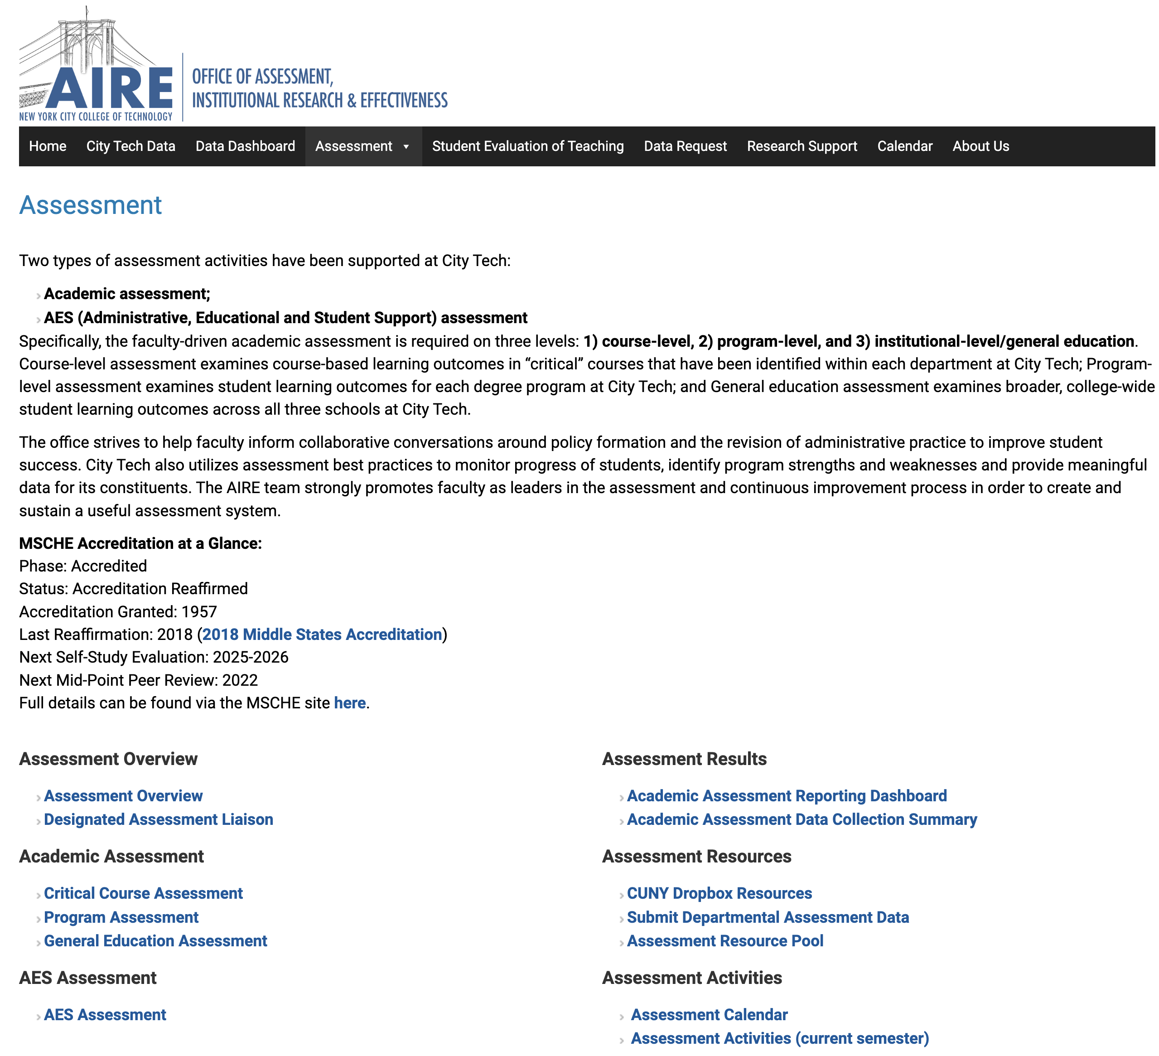
AIRE Assessment Portal
http://air.citytech.cuny.edu/assessment/
assessment structure (i.e., assessment liaisons), calendar, and activities
guidelines, templates, and examples
current assessment status (submissions, feedback)
assessment data collection summary and data results
assessment archive via CUNY Dropbox system

