Slide 1
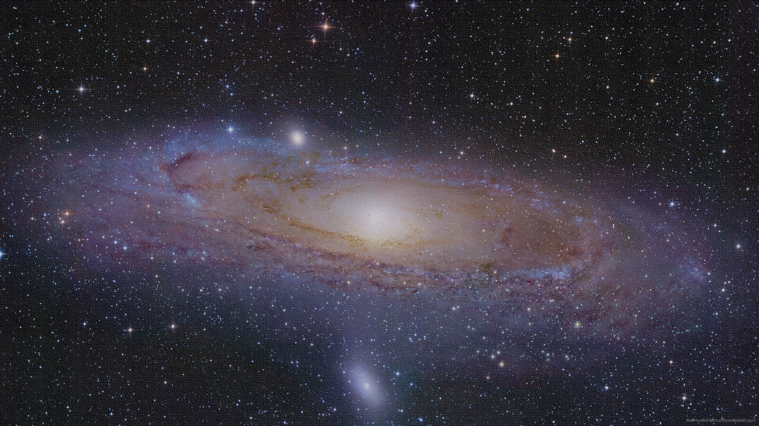
Title of the Poster A. Author1, B. Author2, and C. Author3 Affiliation…
Foundations of Interstellar Studies Workshop at City Tech, CUNY
June 13-15, 2017, New York, NY, USA
Display all your material in this space.

